Slide 1
Hot-Phase Cold-Phase Example

Slide 2
The Objective of this Example
To show how some phenomena can only be modeled with full 3-phase modeling
Symmetrical component modeling does not expose this issue
When distribution lines are not transposed (usually the case) one phase is “hotter” than the others and one phase may.

Slide 3
The Problem

Slide 4
Schematic
12.47 kV
3000 kW

Slide 5
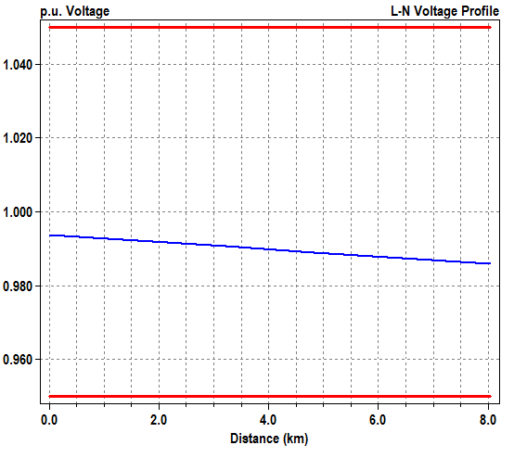
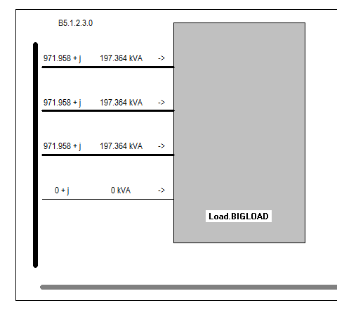
Symmetrical Component Line Model Results

Slide 6
Specifying Line Geometry
New WireData.AL_336_19STR Rac=0.190761 Runits=km GMRac=0.64008 GMRUnits=cm Radius=0.84582 Radunits=cm normamps=453 544
New WireData.ACSR_1/0_6/1 Rac=0.695936 Runits=km GMRac=0.13462 GMRUnits=cm Radius=0.50546 Radunits=cm normamps=271 325
New LineGeometry.336_HORIZ nconds=4 nphases=3
~ cond=1 wire=AL_336_19STR x=-1.39598 h=12.192 units=m
~ cond=2 wire=AL_336_19STR x=0 h=12.192 units=m
~ cond=3 wire=AL_336_19STR x=1.39598 h=12.192 units=m
~ cond=4 wire=ACSR_1/0_6/1 x=0 h=10.9728 units=m
~ reduce=y

Slide 7
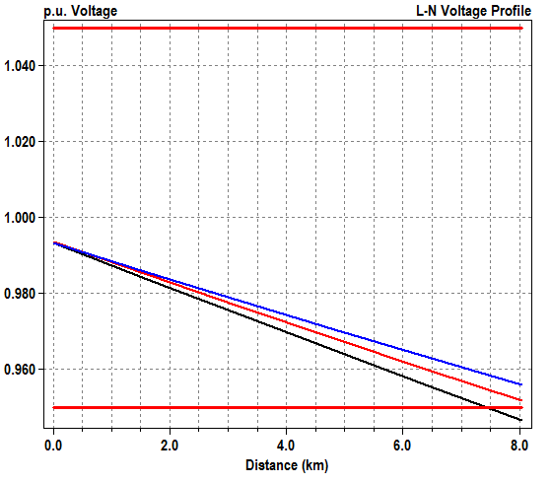
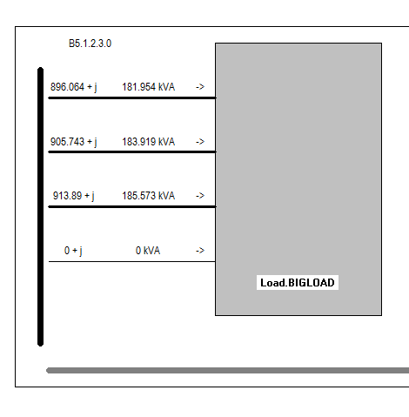
Results with Line Geometry

Slide 8
Mtx601 LineCode from IEEE 13-Bus
! Horizontal Crossarm - B is hot phase
New linecode.mtx601 nphases=3 BaseFreq=60
~ rmatrix = (0.3465 | 0.1560 0.3375 | 0.1580 0.1535 0.3414 )
~ xmatrix = (1.0179 | 0.5017 1.0478 | 0.4236 0.3849 1.0348 )
~ units=mi

Slide 9
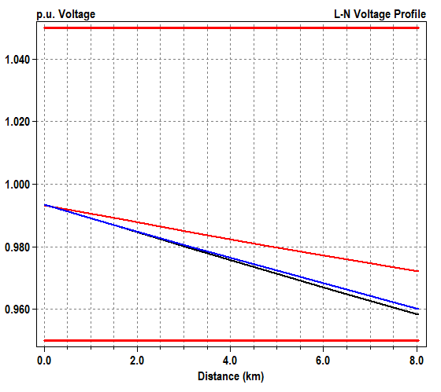
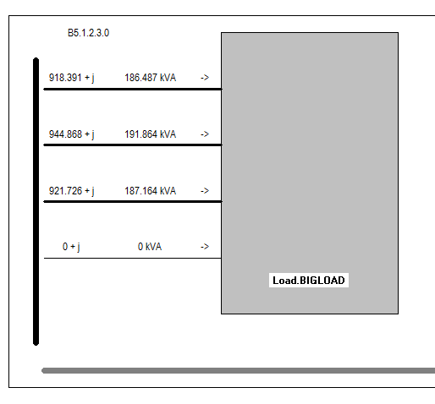
Results from Mtx601 LineCode

Slide 10
A Real Case Where This is Important
Submerged Arc Furnace with Rectangular Electrodes

Slide 11
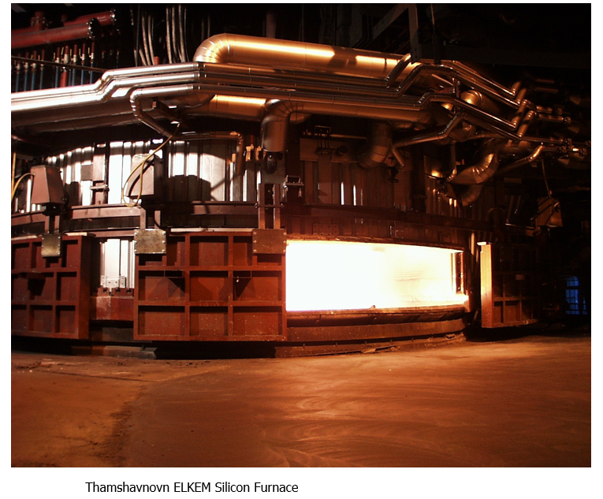
Silicon Metal Submerged Arc Furnace

Slide 12
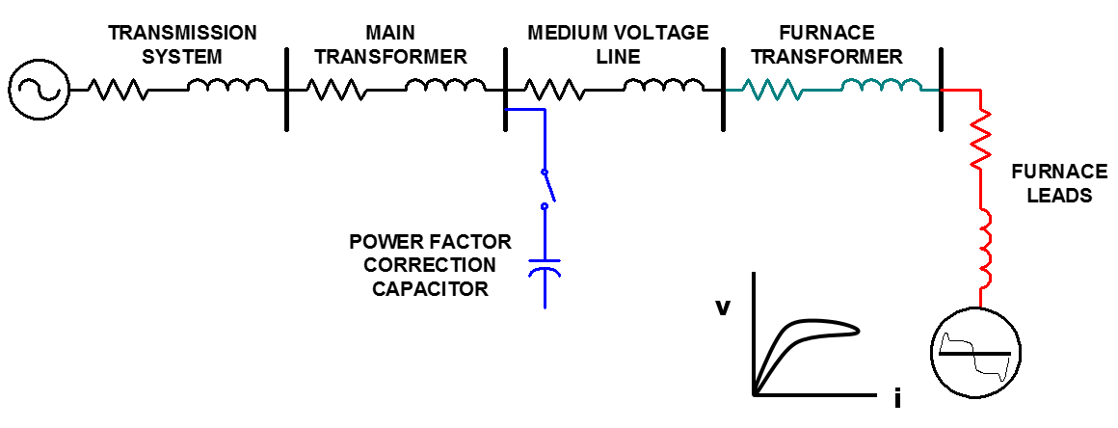
Arc Furnace Power Supply

Slide 13
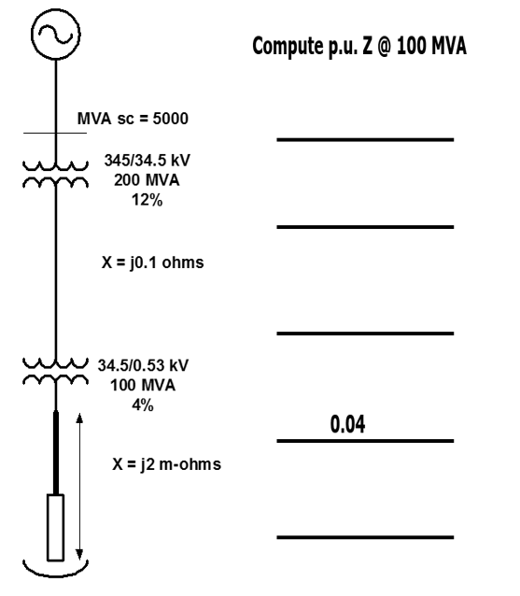
Arc Furnace Model

Slide 14
Together…Shaping the Future of Electricity

